Slide 1

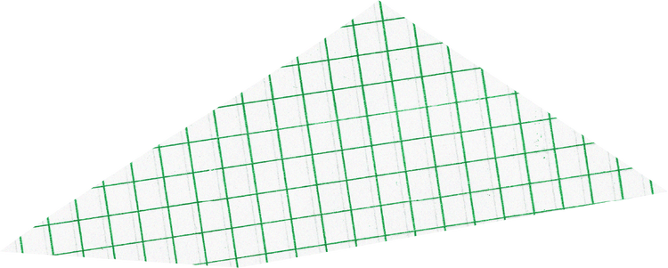






Harue SkinCare Shop

Slide 2








Objective of the Project
  Establish an online platform for selling skincare products.
  Share skincare knowledge and tips to empower users.
  Build a trusted brand presence in Myanmar’s online skincare market.

Slide 3




• HTML
• CSS
• JavaScript

Slide 4


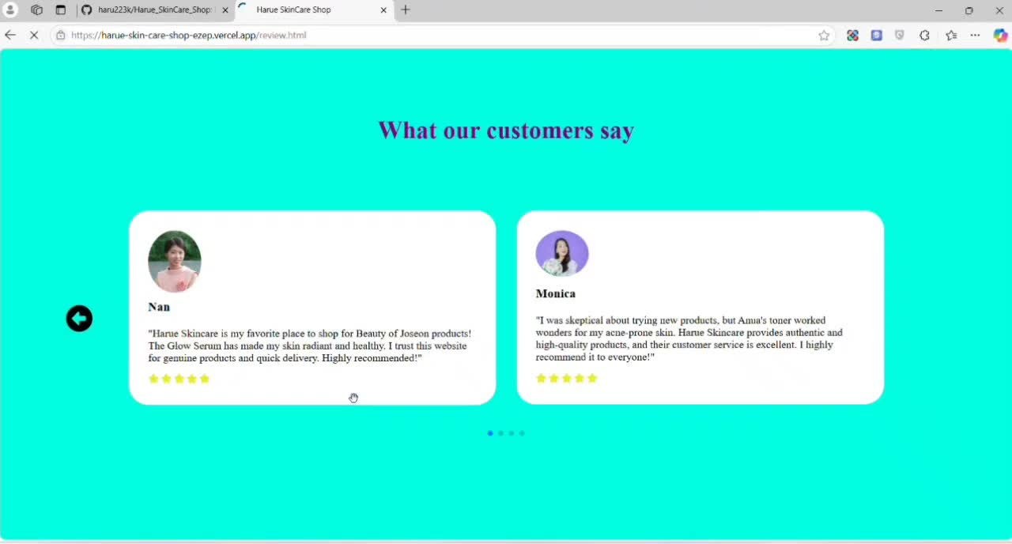


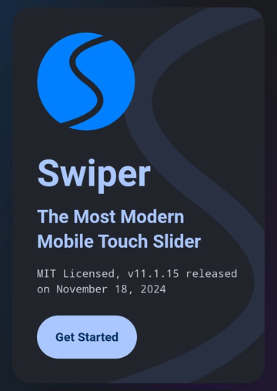
Watch Reviw
• JavaScript Swiper

Slide 5





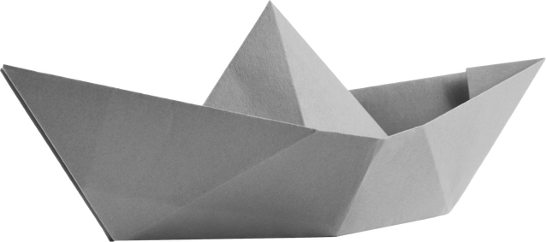
Color uses
Xanadu
For Calm and Sophistication.
Calamansi
Used in header and button text.

Slide 6


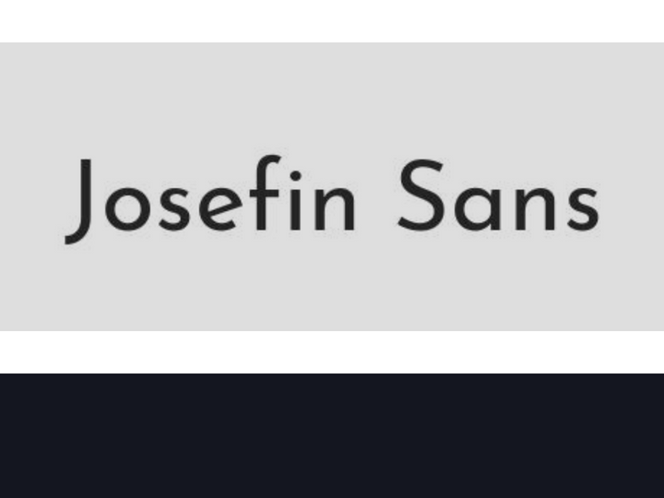
Font uses
Dancing Script
Used in brand name and other section headers.
Eczar
Used in cards header.
Josefin Sans
Used in cards paragraph.

Slide 7
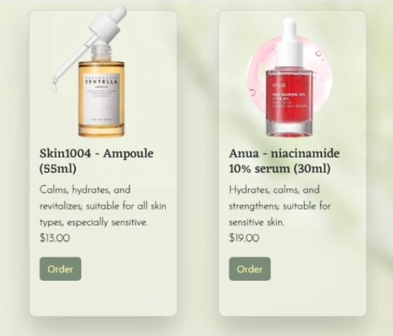
In the shop cards
glassy background
Png image

Slide 8
Thanks for watching..

